Slide 1

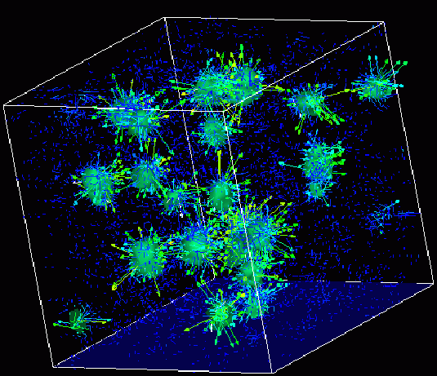
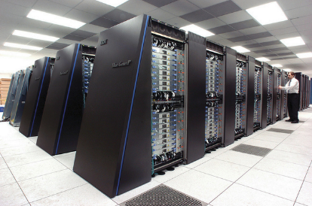
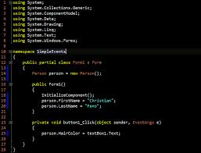
Survey of
Scientific Computing
(SciComp 301)
Dave Biersach
Brookhaven National Laboratory
dbiersach@bnl.gov
Exam 3
Total of 100 points

Slide 2
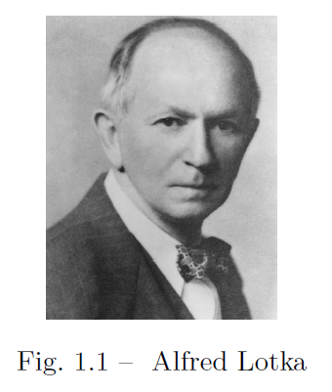
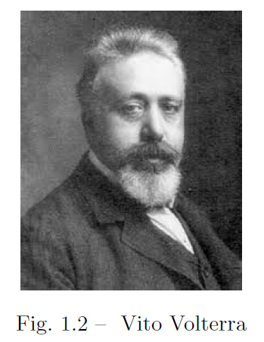
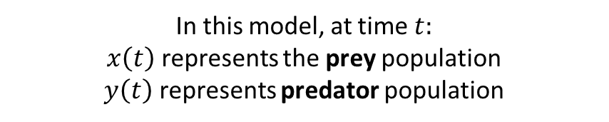


10 pts
1. Predator-Prey Modelling
https://en.wikipedia.org/wiki/Lotka%E2%80%93Volterra_equations
In the q01 folder, edit the C++ CERN ROOT application to calculate the Lotka-Volterra (1920) differential equations for given characteristics & initial conditions
$$α=2, β=1.1, γ=1.0, δ=0.9$$
$$x\left(0\right)=1, y\left(0\right)=0.5$$
In this model, at time $t:$
$x\left(t\right)$ represents the prey population
$y\left(t\right)$ represents predator population
Their system of coupled non-linear first order differential equations will be solved using the 4th order Runge-Kutta method

Slide 3
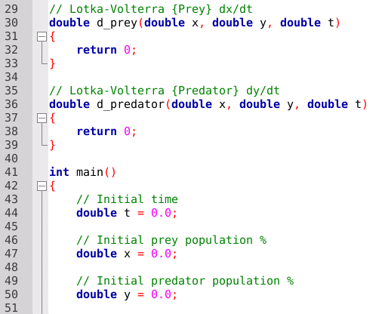


1. Predator-Prey Modelling
You must write this function
d_prey() = $\frac{dx}{dt}$
You must write this function
d_predator() = $\frac{dy}{dt}$
Provide these values

Slide 4
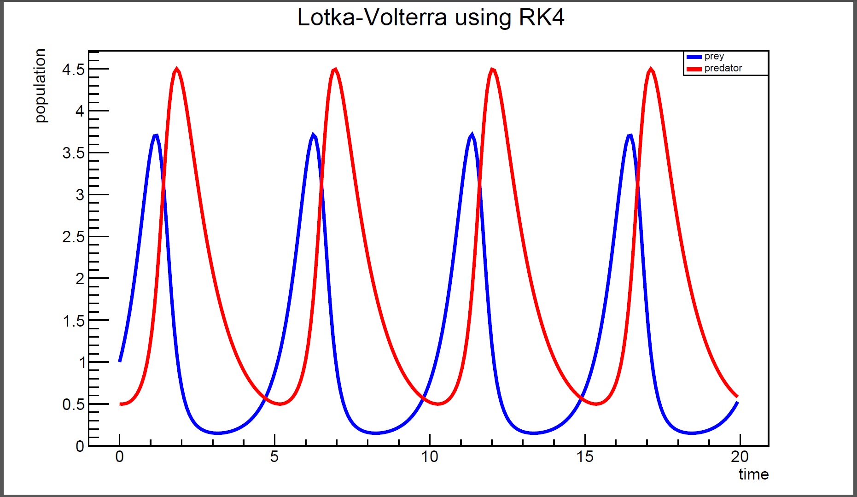
1. Predator-Prey Modelling
Expected Output (Approved Solution)

Slide 5
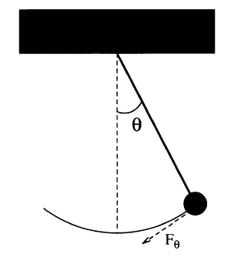

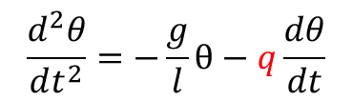

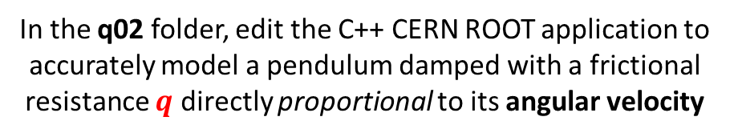




15 pts
2. Damped Pendulum
In the q02 folder, edit the C++ CERN ROOT application to accurately model a pendulum damped with a frictional resistance $q$ directly proportional to its angular velocity
Referring to Session 19 Lab 04, we must introduce an additional resistive force term into the equation of motion
$$q$$
$$\frac{d^{2}θ}{dt^{2}}=−\frac{g}{l}θ−q\frac{dθ}{dt}$$
Dampening force constant $q$
Euler-Cromer Difference Equations
$$\frac{dω}{dt}=−\frac{g}{l}θ−q\frac{dθ}{dt}$$
$$ω_{i+1}=ω_{i}−\frac{g}{l}θ_{i}Δt−{qω}_{i}Δt$$
$$\frac{dθ}{dt}=ω$$
$$θ_{i+1}=θ_{i}+ω_{i+1}Δt$$

Slide 6
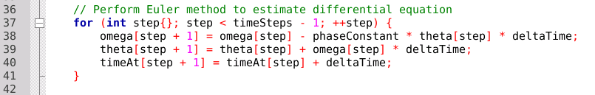


2. Damped Pendulum
Assume a damping factor $q=1$
$$ω_{i+1}=ω_{i}−\frac{g}{l}θ_{i}Δt−{qω}_{i}Δt$$
Add damping term
Insert Cromer’s correction
$$θ_{i+1}=θ_{i}+ω_{i+1}Δt$$

Slide 7
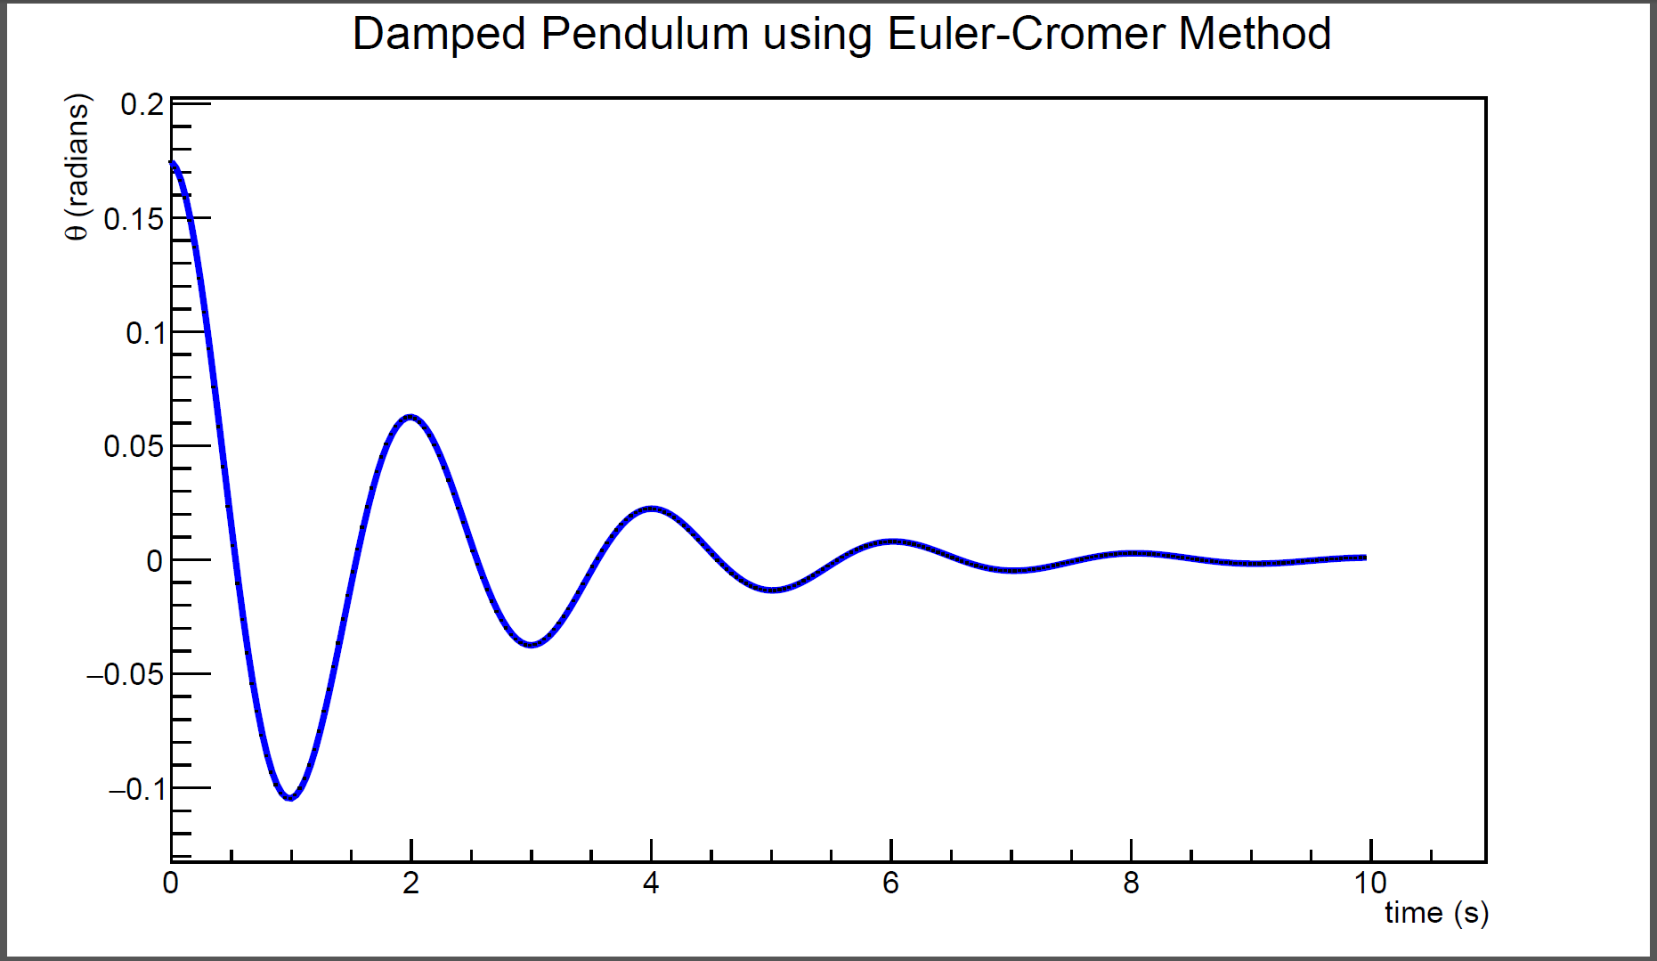
2. Damped Pendulum
Expected Output (Approved Solution)

Slide 8
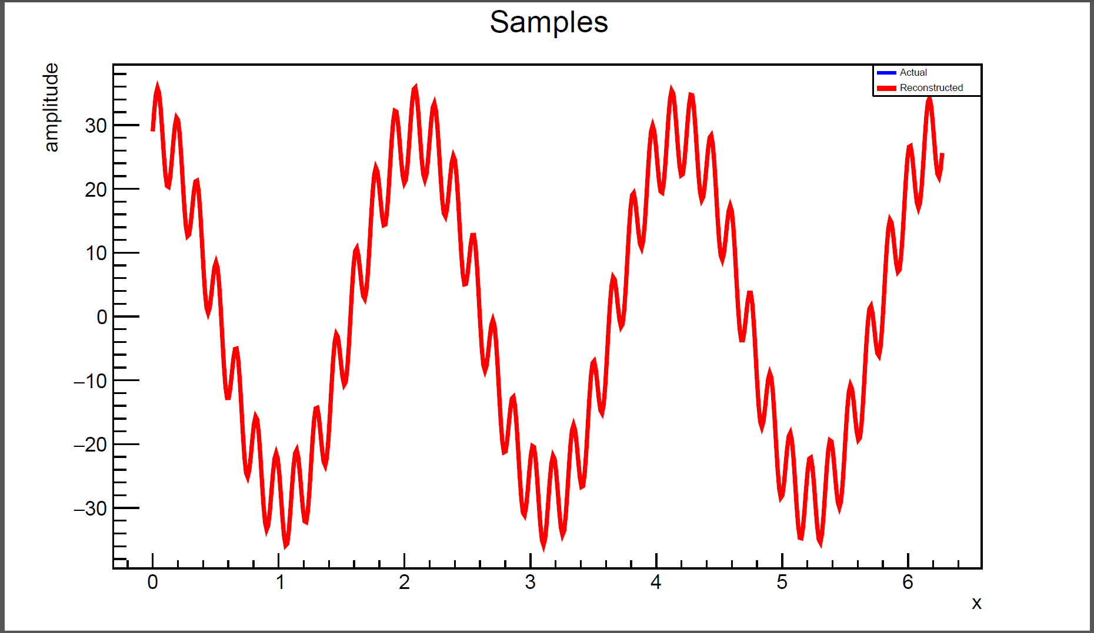
15 pts
3. High Frequency Filter
In the q03 folder, edit the C++ CERN ROOT application to filter out the high frequency noise embedded in a signal using the methods learned in Session 21
High frequency interference is distorting the capture of a clean primary signal. We want to remove this interference when reconstructing the signal using the inverse discrete Fourier transform (IDFT)

Slide 9
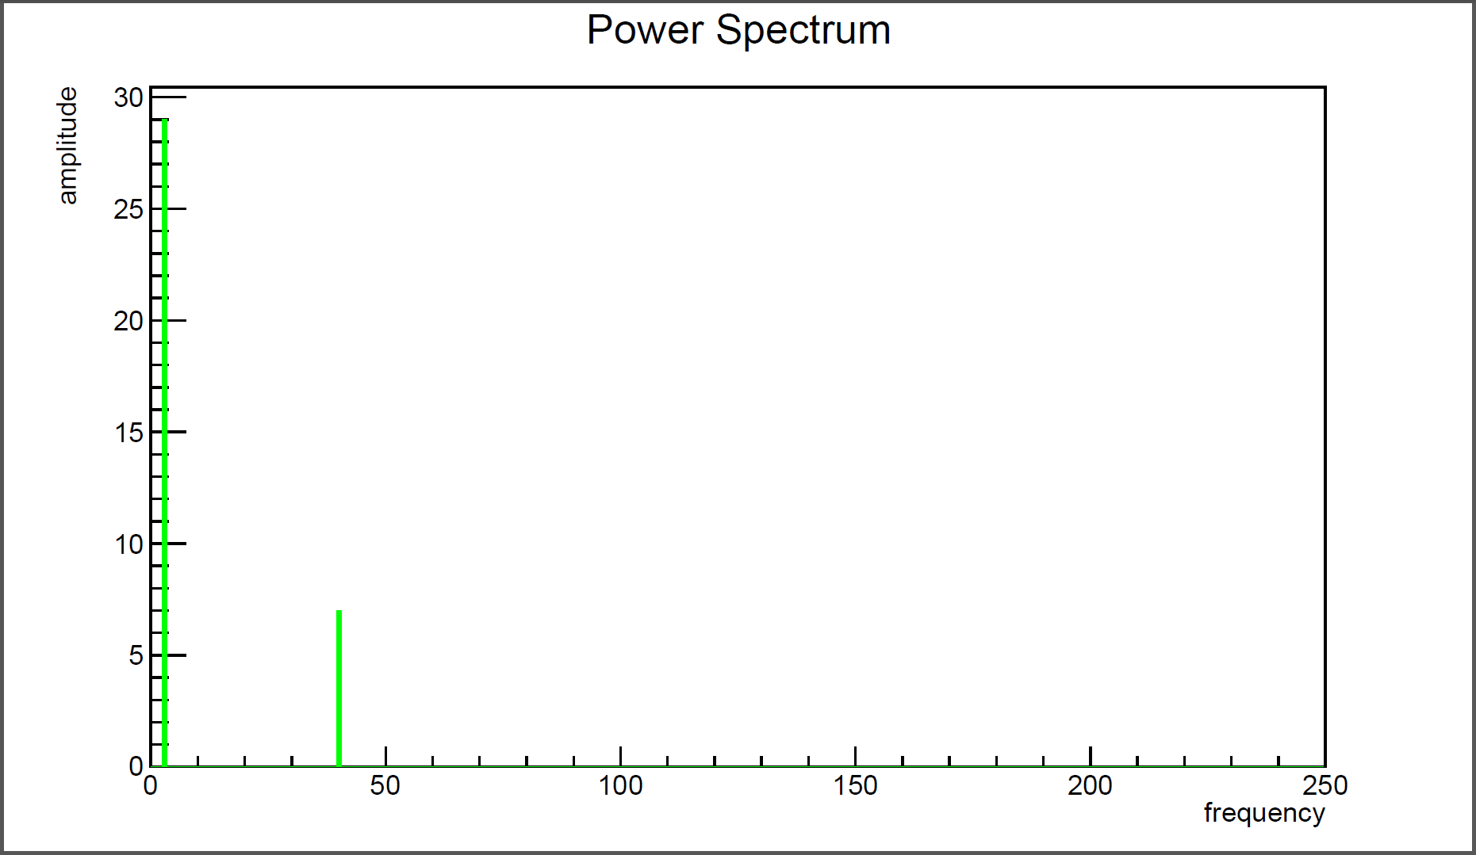
3. High Frequency Filter
The DFT identifies the constituent simple waves composing the complex wave. By ignoring high frequency simple waves when reconstructing the signal using the IDFT, the interference can be removed
This is the primary signal
This is high frequency interference

Slide 10
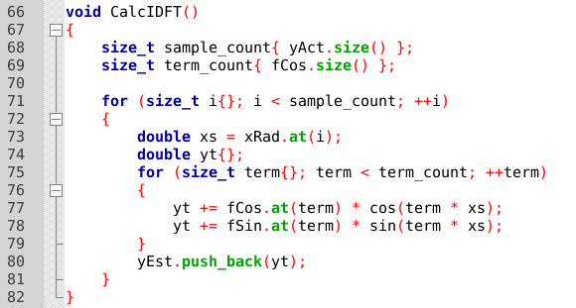
3. High Frequency Filter
The term # is the frequency of each successive simple wave
Insert logic to not add high frequency waves back into the reconstructed signal

Slide 11
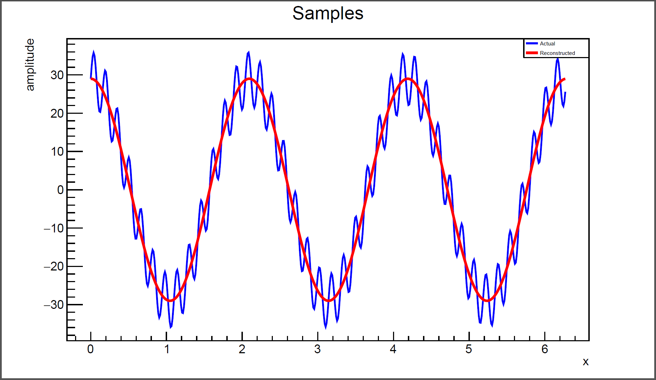
3. High Frequency Filter
Expected Output (Approved Solution)

Slide 12
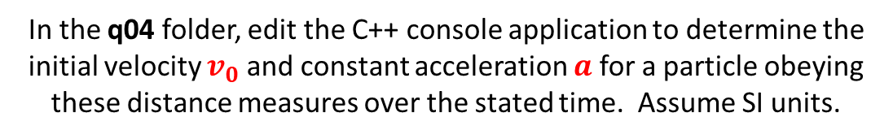
10 pts
4. Newtonian Kinematics
In the q04 folder, edit the C++ console application to determine the initial velocity $v_{0}$ and constant acceleration $a$ for a particle obeying these distance measures over the stated time. Assume SI units.
Using the method of least squares, fit an appropriate equation from kinematics that governs the behavior of this particle

Slide 13


4. Newtonian Kinematics
Enter given data
x = time, y = distance
Edit code to display correct values for acceleration and initial velocity

Slide 14

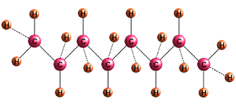
10 pts
5. Combustion of Octane
In the q05 folder, edit file octane.txt to correctly balance the combustion reaction equation of gasoline
Ensure the application emits the correct molar ratios
Refer to Session 17 for assistance on how to encode a chemical equation into the expected input file format

Slide 15
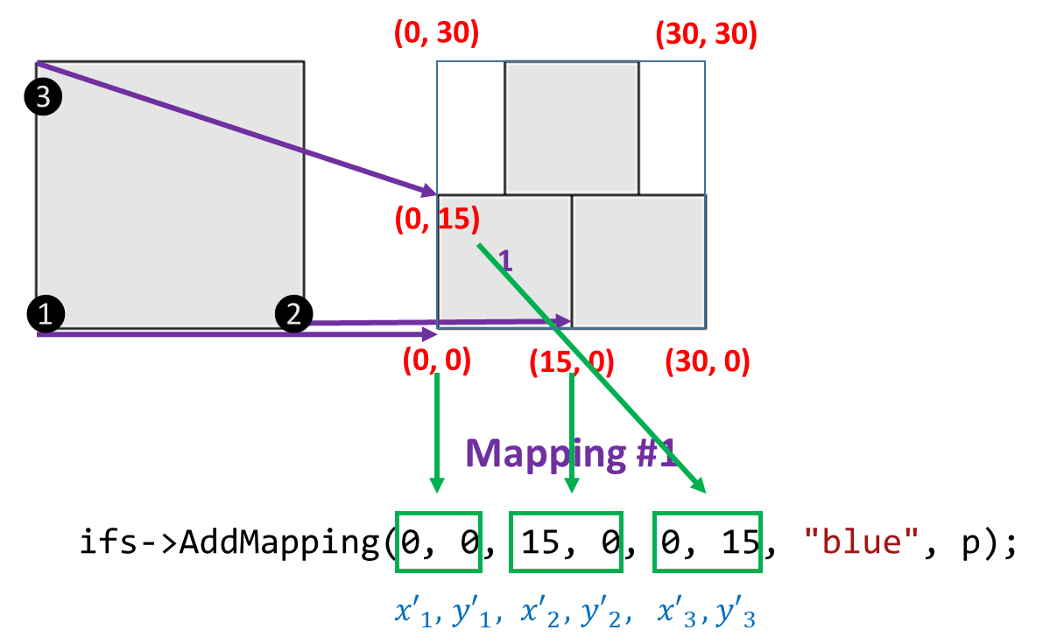
15 pts
6. Hexagonal Fractal
In the q06 folder, edit the C++ Allegro application to draw a hexagonal fractal using an Iterated Function System
Provide the necessary coordinates to create six affine transforms (mappings) that cover a regular hexagon with side length 10
Refer to Session 24 for assistance on how to encode mappings

Slide 16
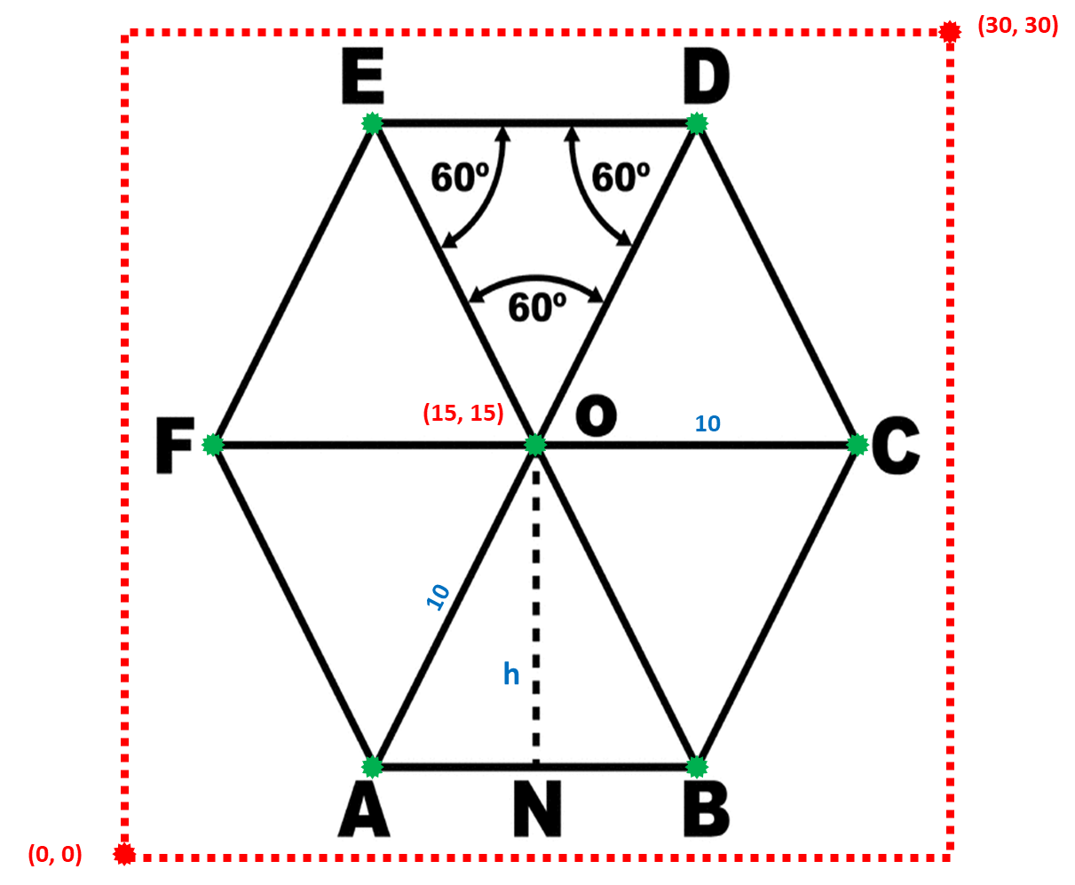
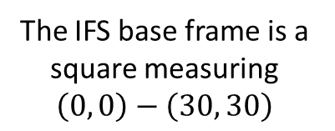
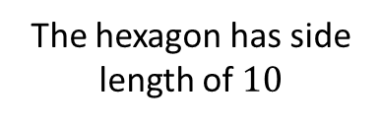
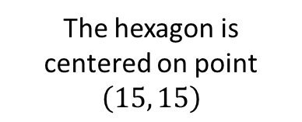
6. Hexagonal Fractal
The IFS base frame is a square measuring
$$\left(0, 0\right)−\left(30, 30\right)$$
The hexagon is centered on point
$$\left(15, 15\right)$$
The hexagon has side length of $10$

Slide 17
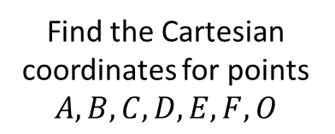
6. Hexagonal Fractal
Find the Cartesian coordinates for points $A,B,C,D,E,F,O$
Encode these six mappings:
COD
DOE
EOF
FOA
AOB
BOC

Slide 18
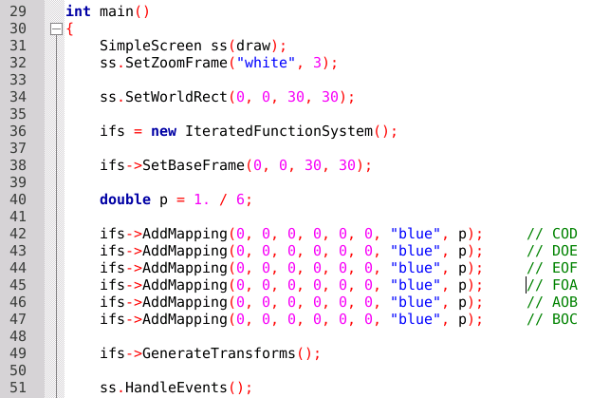
6. Hexagonal Fractal
Edit these lines

Slide 19
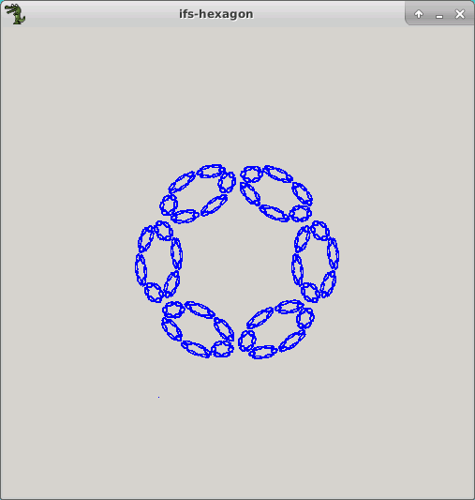
6. Hexagonal Fractal
This is just one possible solution

Slide 20
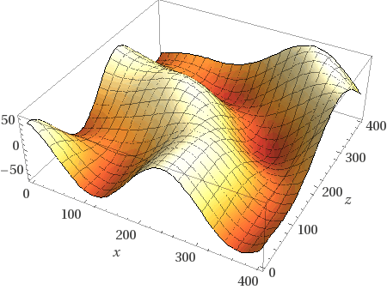
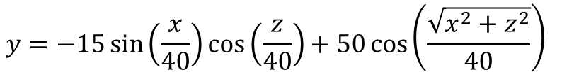
5 pts
7. Surface Interpolation
In the q07 folder, edit the C++ Allegro application to determine the optimal IDW power that minimizes the RMSD of this model
$$y=−15\sin\left(\frac{x}{40}\right)\cos\left(\frac{z}{40}\right)+50\cos\left(\frac{\sqrt{x^{2}+z^{2}}}{40}\right)⁡$$

Slide 21
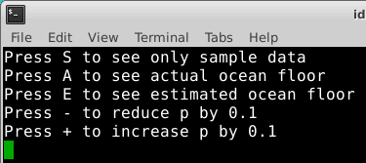

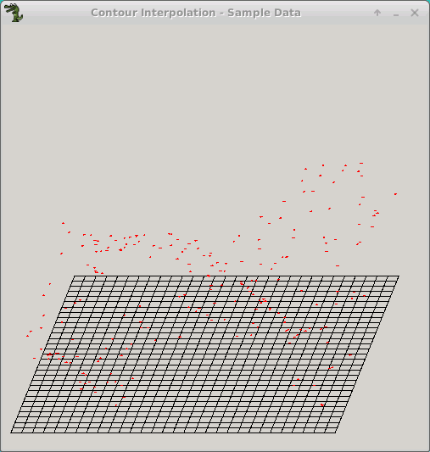
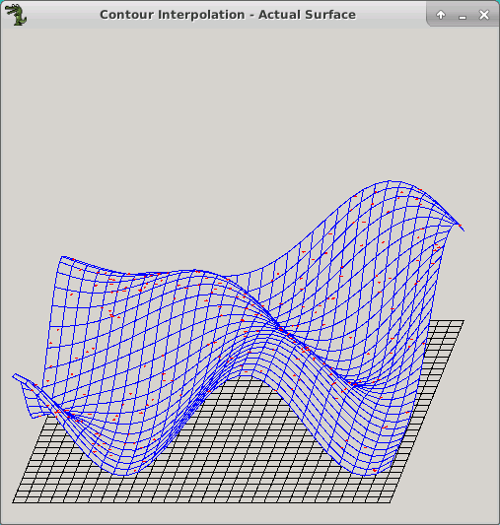
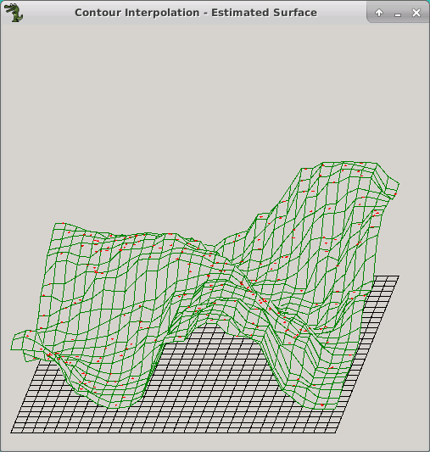
7. Surface Interpolation
Edit this function

Slide 22
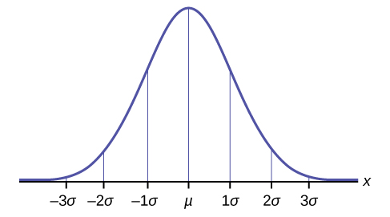
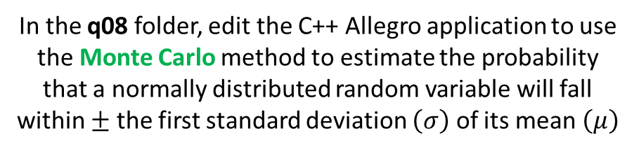
15 pts
8. Standard Normal Monte Carlo
In the q08 folder, edit the C++ Allegro application to use the Monte Carlo method to estimate the probability that a normally distributed random variable will fall within $±$ the first standard deviation $\left(σ\right)$ of its mean $\left(μ\right)$
The integral (the area under the curve) of a continuous probability distribution (CDF) indicates the probability an observation will occur within that measure window
Assume we have a standard normal distribution for this problem!

Slide 23
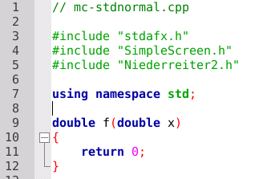
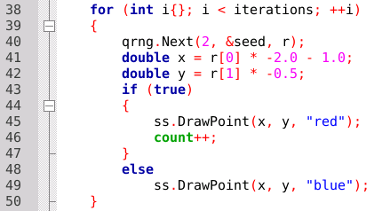
8. Standard Normal Monte Carlo
We will use the Niederreiter QRNG
Implement the function for a standard normal CDF
Edit this logic to only count points that are under the curve f(x)

Slide 24
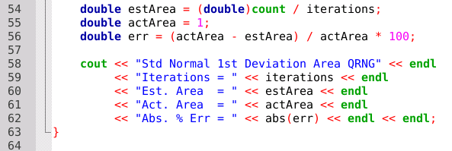
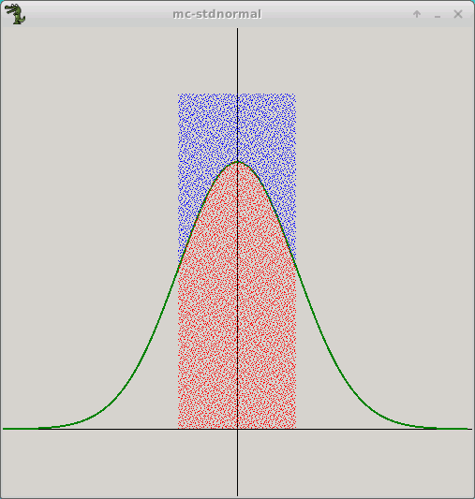

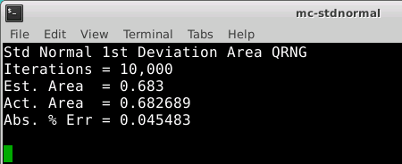

8. Standard Normal Monte Carlo
Insert the actual (expected) value for this area
$$\frac{{dots}_{inside}}{{dots}_{total}}=\frac{{area}_{under curve}}{{area}_{rectangle}}$$
Expected Output (Approved Solution)
0.5
2

Slide 25
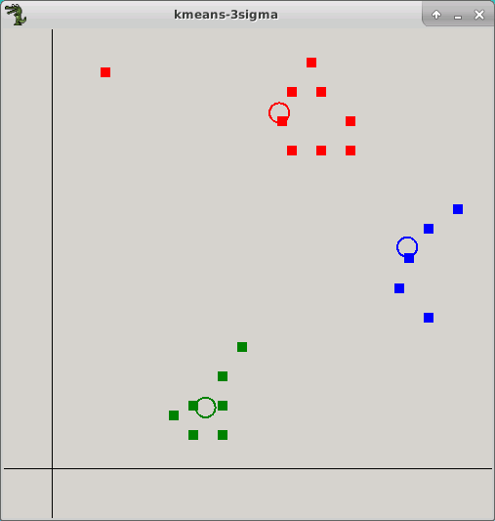

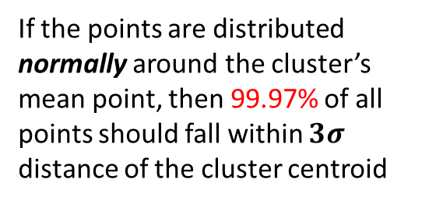
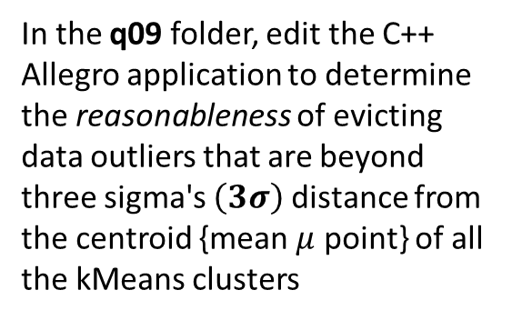
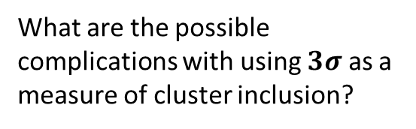

5 pts
9. kMeans Eviction Criteria
In the q09 folder, edit the C++ Allegro application to determine the reasonableness of evicting data outliers that are beyond three sigma's $\left(3σ\right)$ distance from the centroid {mean $μ$ point} of all the kMeans clusters
$$3σ$$
If the points are distributed normally around the cluster’s mean point, then 99.97% of all points should fall within $3σ$ distance of the cluster centroid
What are the possible complications with using $3σ$ as a measure of cluster inclusion?

Slide 26
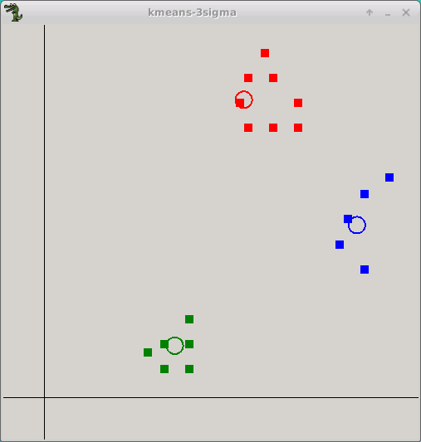
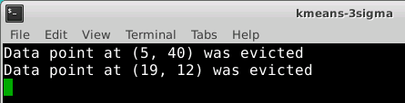
5 pts
9. kMeans Eviction Criteria
Before evictions
After evictions
Did we evict too many data points? Does the algorithm converge?

Slide 27
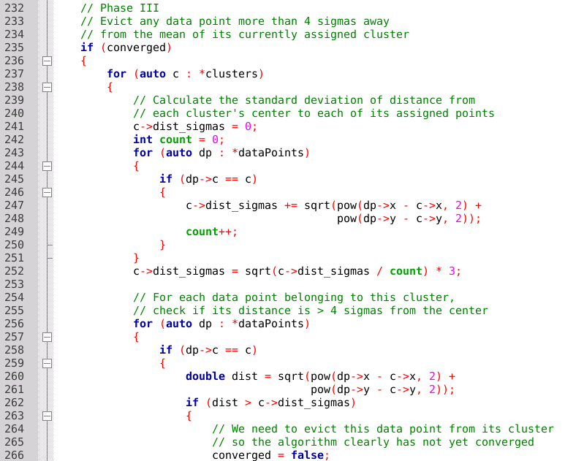
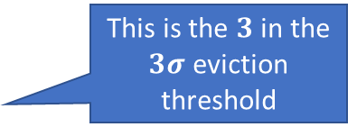
5 pts
9. kMeans Eviction Criteria
This is the $3$ in the $3σ$ eviction threshold

Slide 28
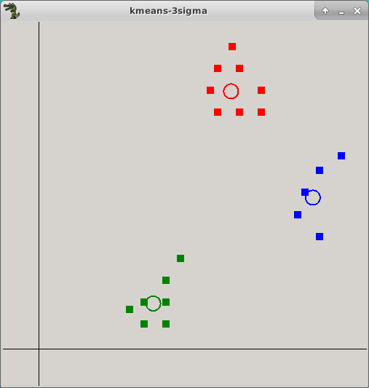
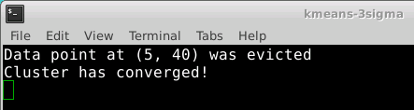

5 pts
9. kMeans Eviction Criteria
Before evictions
After evictions
Which values of $n$ in the cutoff metric of $nσ$ will only prune likely true outliers?

